Slide 1
Project Weather IO
Mälardalen University - Fall of 2016
Alex Eskandar Anis, Johan Söderling Åström
{eas12003, jam12003}@student.mdh.se

Slide 2
Introduction
Discover the environments
MDH owned weather station
Publicly accessible

Slide 3
Approach
ATmega 2560 microcontroller
256 kBytes flash
16 MHz operating frequency
8-bit architechture
86 IO pins
32 External interrupts
5 SPI
Communication protocols
DIO, AIO
I2C
UART
ATmega 2560 to Server: TCP
HTTP Server
GSM - Global System for Mobile Communications
Off the shelf and constructed sensors
Languages: C, C++

Slide 4
Sensing
Time
Temperature
Humidity
Carbon dioxide CO2
Carbon monoxide CO
UV radiation A and B
Rain
Methane
Butane
Barometric pressure
Altitude
Sun position and distance
Sunrise, sunset, solar noon times
Moon position and distance
Moon rise and set times.
Moon phases and visibility
Environment noise level

Slide 5
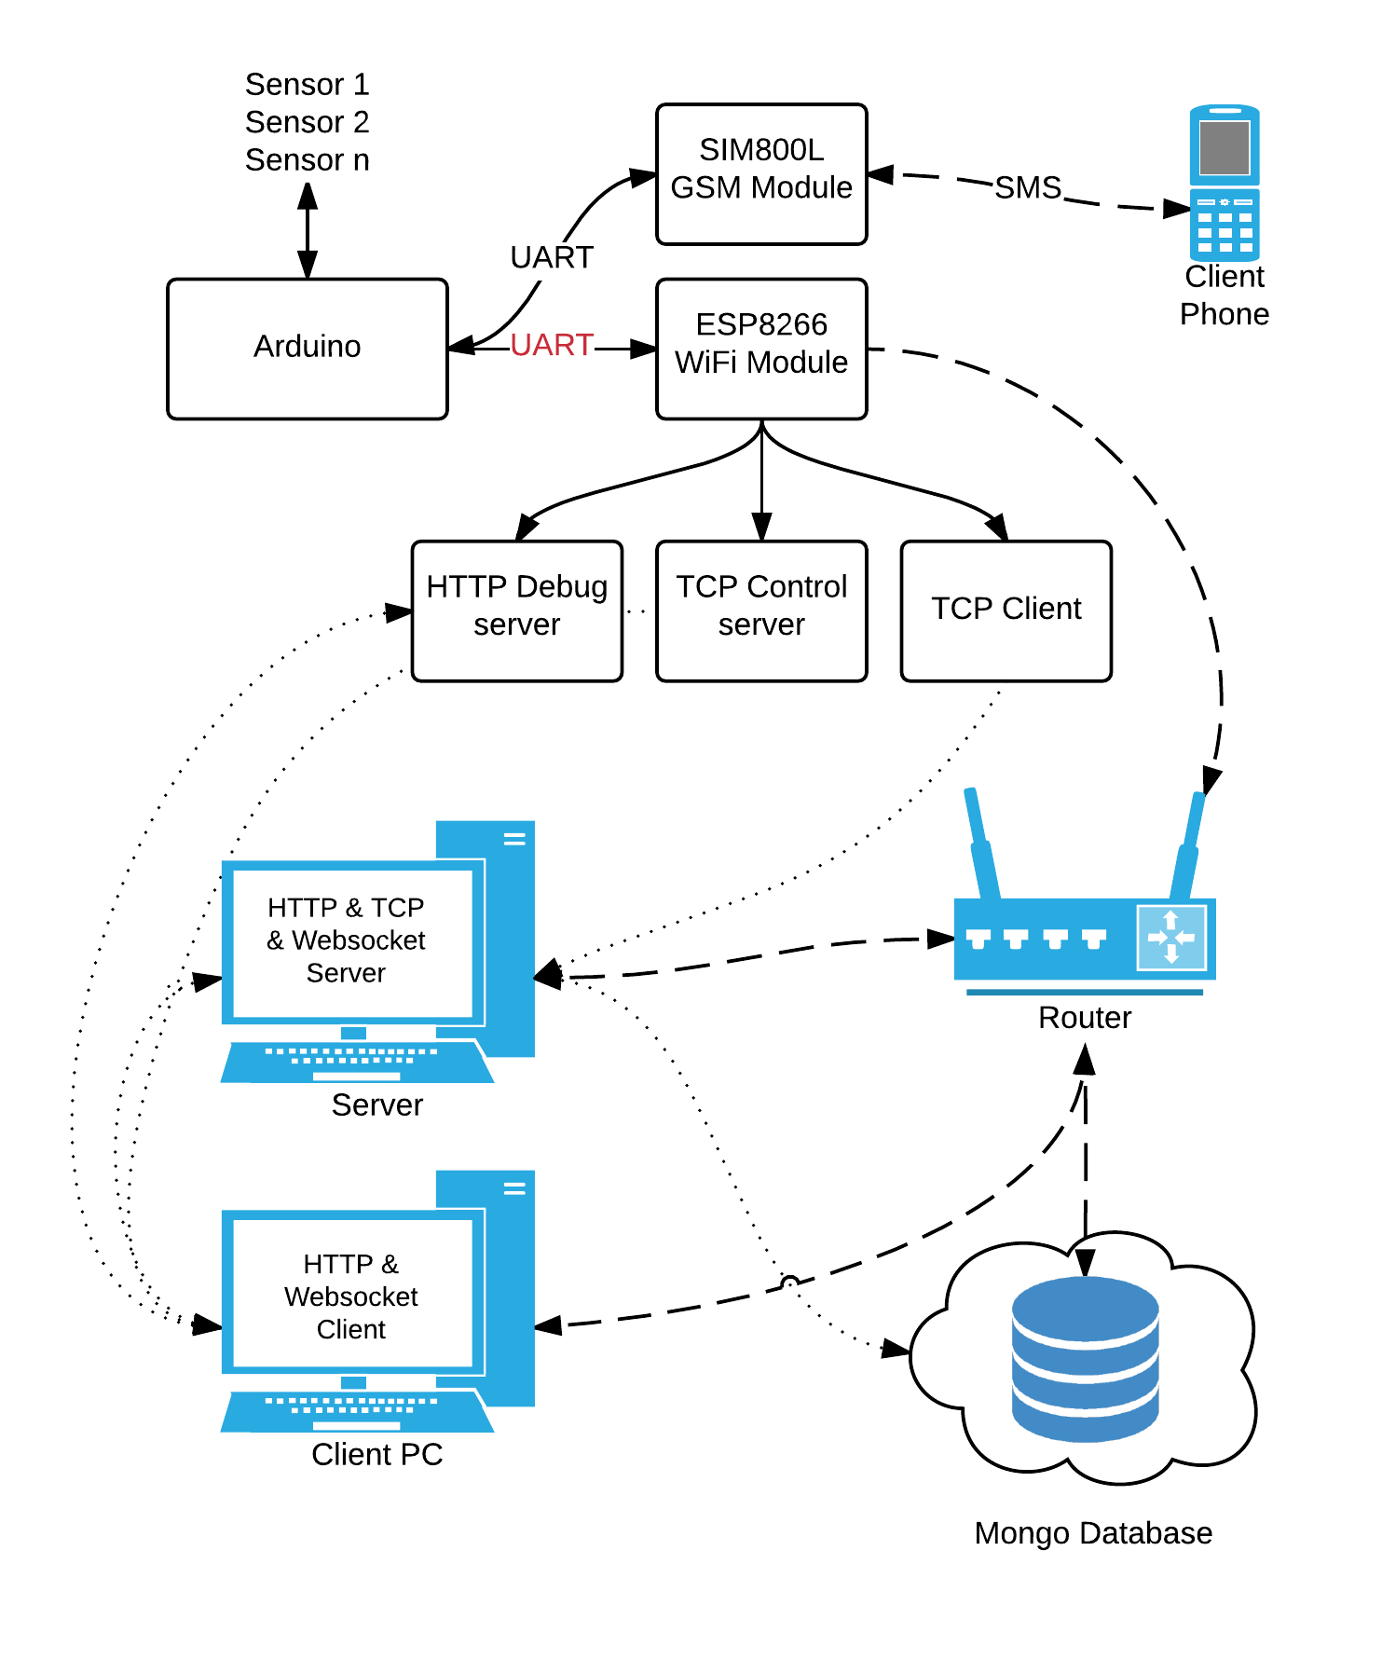
Method

Slide 6
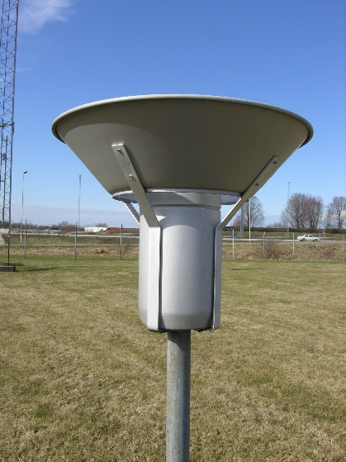
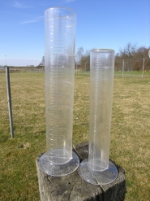
Issue: Rainfall
It’s difficult to measure rainfall precisely due to:
Wind
Evaporation
Hail
Snow
Manual swedish rainfall measruments device
Measuring cups used by SMHI

Slide 7
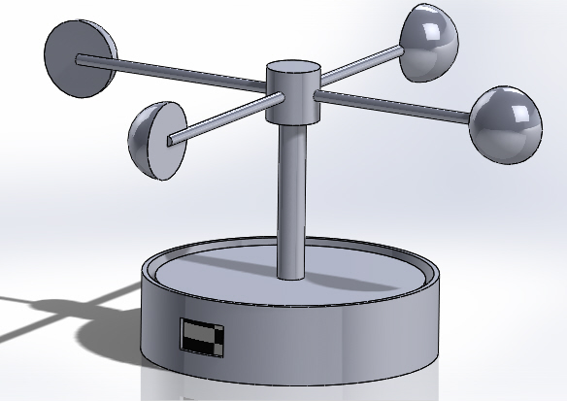
Issue: Wind speed
Anemometers and wind direction sensors are expensive.
Some ideas:
Using a Photosensor
Photosensor with pendulum
Anenmometer with photosensor.

Slide 8
Results and future work
Weather station is almost complete.
Still waiting for some essential parts.
Mill the motherboard PCB
Total estimated cost: 530 SEK including wireless communication for TCP and GSM.
Move the server to MDH computer.
Last updated: 2015-05-25

Slide 9
Project Weather IO
Mälardalen University - Fall of 2016
Alex Eskandar Anis, Johan Söderling Åström
{eas12003, jam12003}@student.mdh.se

